Slide 1
Sea Turtles and Global Warming

Slide 2
Global warming is a big problem that affects our planet. It means the Earth is getting hotter, which changes weather patterns and impacts many animals. One animal that is greatly affected by global warming is the sea turtle

Slide 3
Sea turtles live in oceans around the world. They need warm beaches to lay their eggs. The rising temperatures are causing changes in their nesting sites. Some beaches are getting too hot, which can harm the eggs.

Slide 4
Effects of Global Warming on Sea Turtles
1. Temperature Changes: Warmer sand can lead to more female turtles being born. This is a problem because a balanced number of males and females is needed for the population to survive.
2. Rising Sea Levels: As ice melts, sea levels rise, which can flood nesting beaches. This makes it harder for turtles to find safe places to lay their eggs.
3. Coral Bleaching: Many sea turtles eat jellyfish, which thrive in warmer waters. However, warmer oceans also harm coral reefs, disrupting the entire ecosystem.

Slide 5
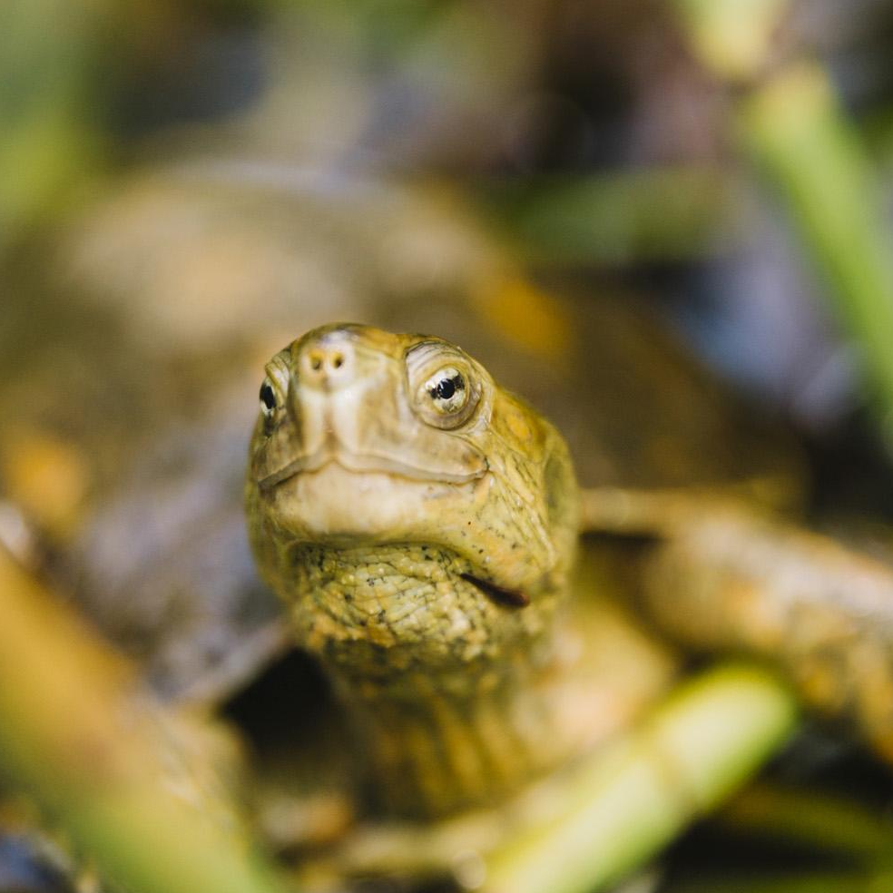
If global warming continues, sea turtles could face serious challenges. Their numbers may decrease if they cannot find safe nesting sites or if their food sources are affected. Protecting our environment is crucial for their survival.

Slide 6
We can help sea turtles by:
• Reducing plastic waste to keep oceans clean.
• Supporting conservation efforts that protect nesting beaches.
• Spreading awareness about the effects of global warming.

Slide 7
Global warming is a serious threat to many animals, including sea turtles. By understanding these issues, we can take steps to protect them and our planet. Thank you!

